Slide 1




Diamond Detectors for Uses in a Proton Therapy Beam
Holly Johnson, Anna Zaniewski, Robert Nemanich, Jason Holmes, Ricardo Alarcon

Slide 2
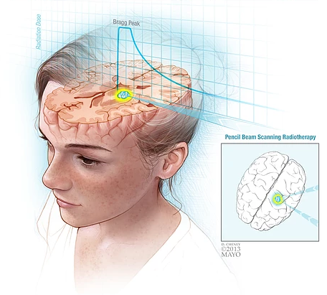
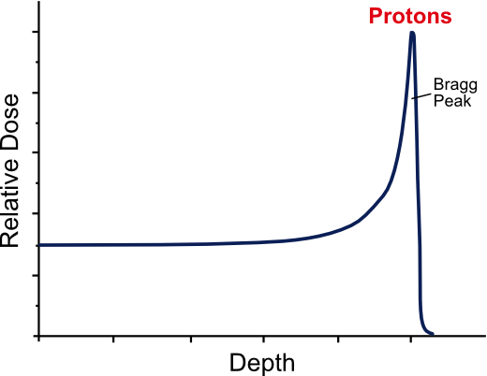
What is Proton Beam Therapy?
An idealized graph of a Bragg Peak; this is how protons release their energy.
A “pencil beam” diagram; this shows how a Bragg peak would be used to treat a brain tumor.
Particle Therapy Cancer Research Institute: Introduction, Oxford Martin School, https://www.ptcri.ox.ac.uk/research/introduction.shtml. Accessed 28 Mar. 2018.

Slide 3
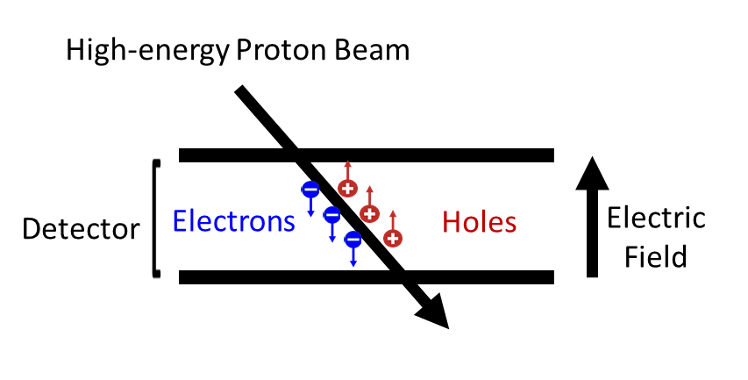
Detectors and how they work
Semi-conductors
Electron-hole pairs
Metal electrodes
Connected to a circuit

Slide 4
Why Diamond?

Slide 5
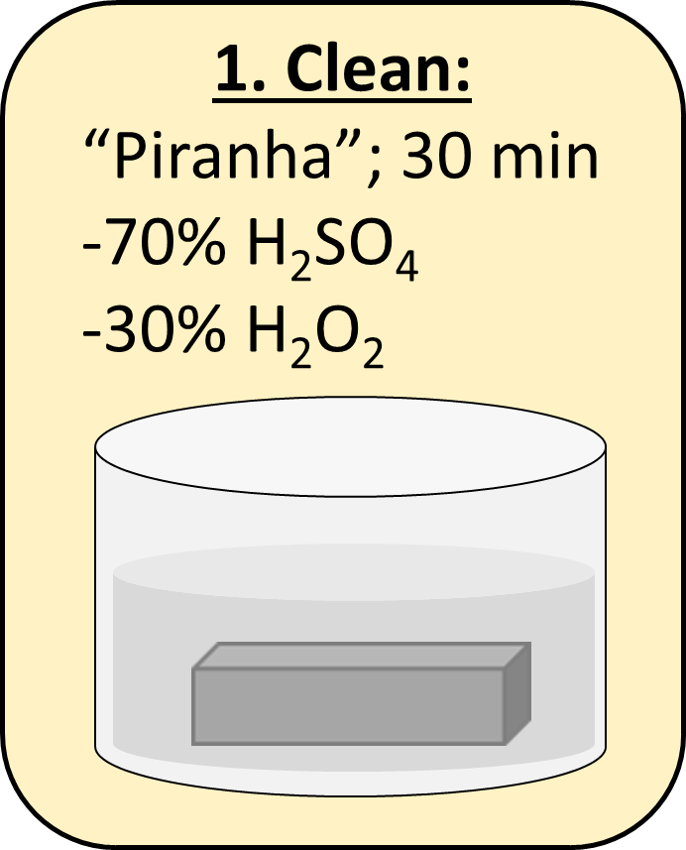
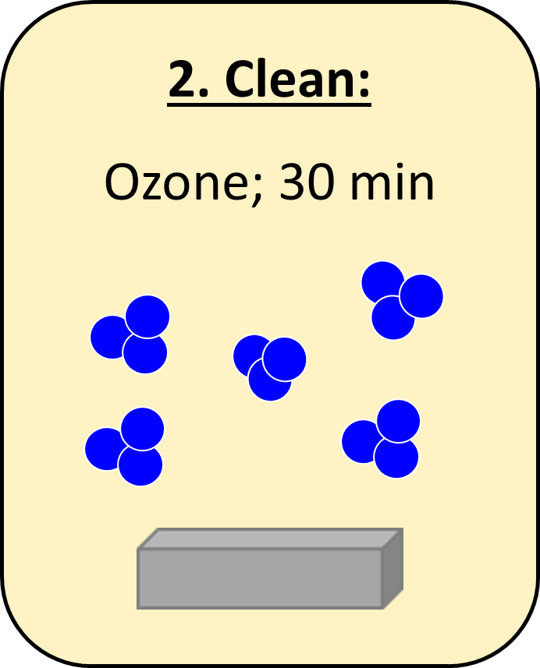
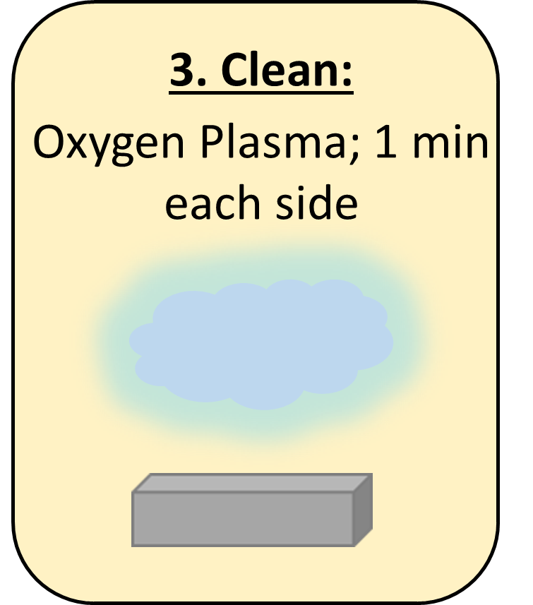
Fabrication and Cleaning
CVD – Chemical Vapor Deposition
Not naturally-occurring or mined
Piranha
Ozone
Oxygen Plasma

Slide 6
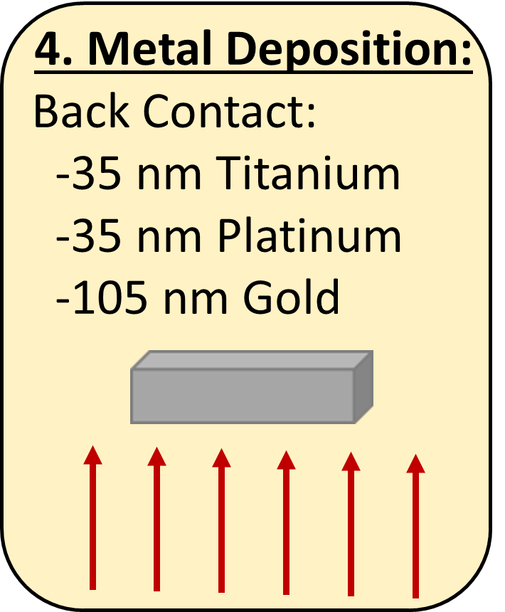
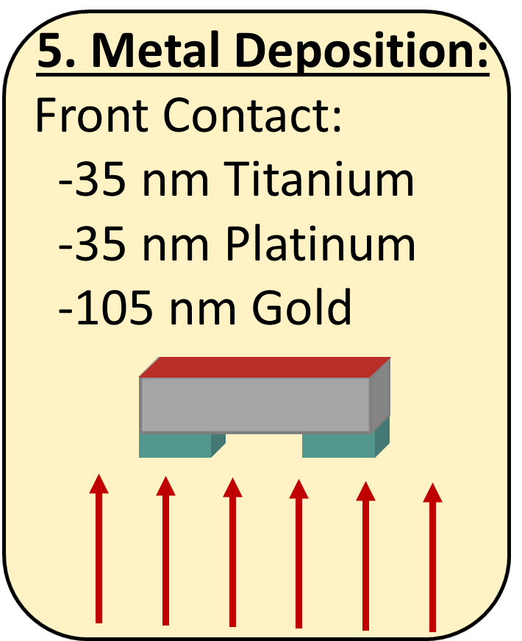
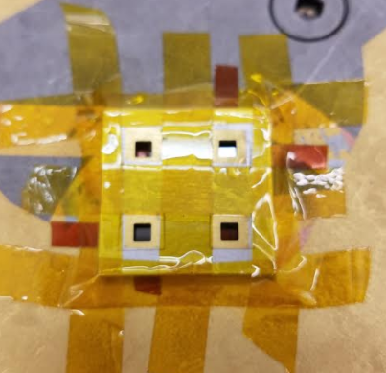
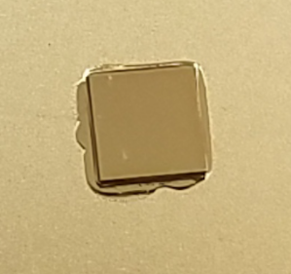
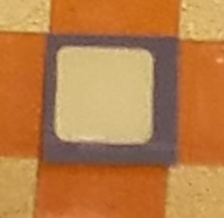
Metal Deposition
Titanium, Platinum, Gold sandwich
Gold does not oxidize
Complete backside
Partial frontside

Slide 7
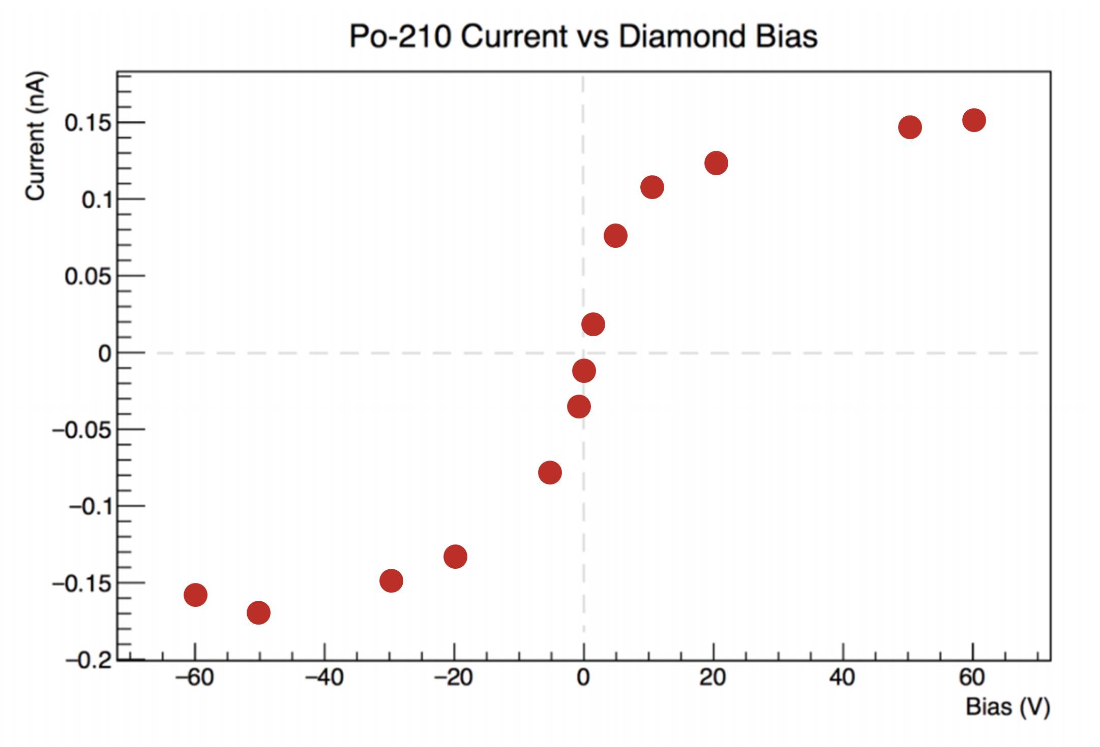
Results
Van Engelhoven, Trevor. Diamond Detector Fabrication for Proton Beam Therapy. Senior thesis. Arizona State University, 2017.

Slide 8
Future Steps

Slide 9
Acknowledgements
I would like to acknowledge Anna Zaniewski for mentoring me both professionally and personally. Jason Holmes has been instrumental in this research and I would like to acknowledge his work as well as the graphs he created in this presentation. I would also like to acknowledge Robert Nemanich, Ricardo Alarcon, Manpuneet Benipal, and Trevor van Engelhoven for helpful discussion. I also acknowledge Mayo Clinic and the ASU/NASA Space Grant program.
Thank you.

Slide 10
Questions?

